Slide 1
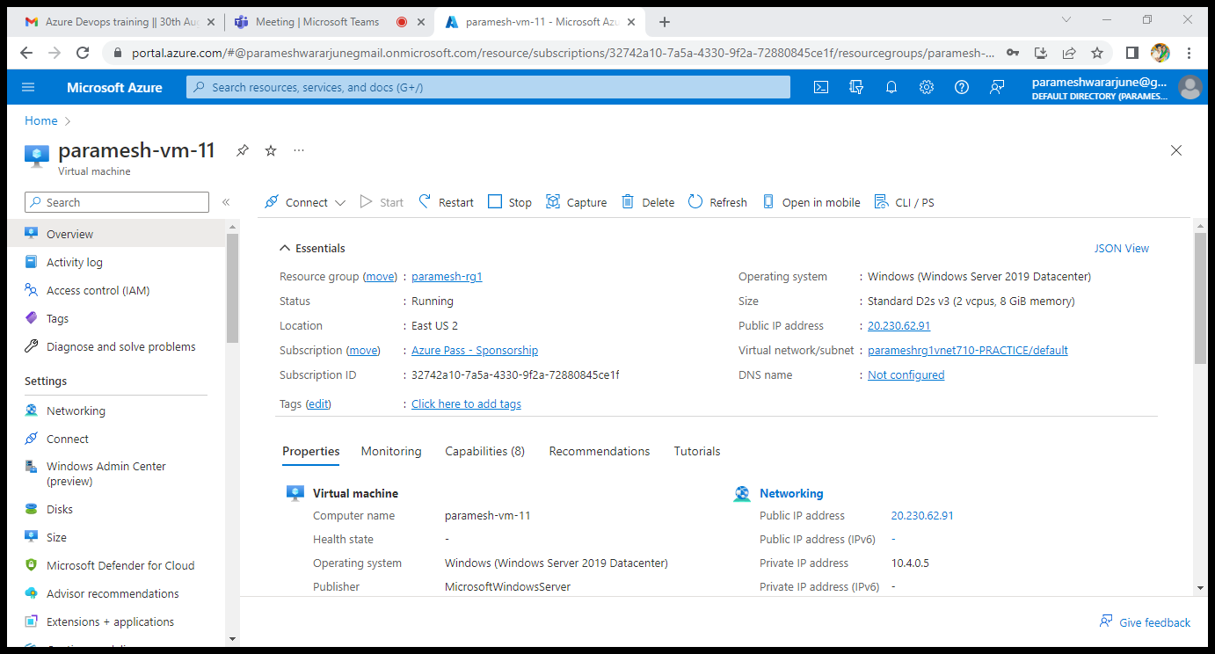
CREATUION OF VERTUAL MACHINE

Slide 2
Connecting to RDP with IP address
Successfully connected to the rdp
Ip address is :-20.230.62.91
Username:-prem
Password :-Paramesh@123PA

Slide 3
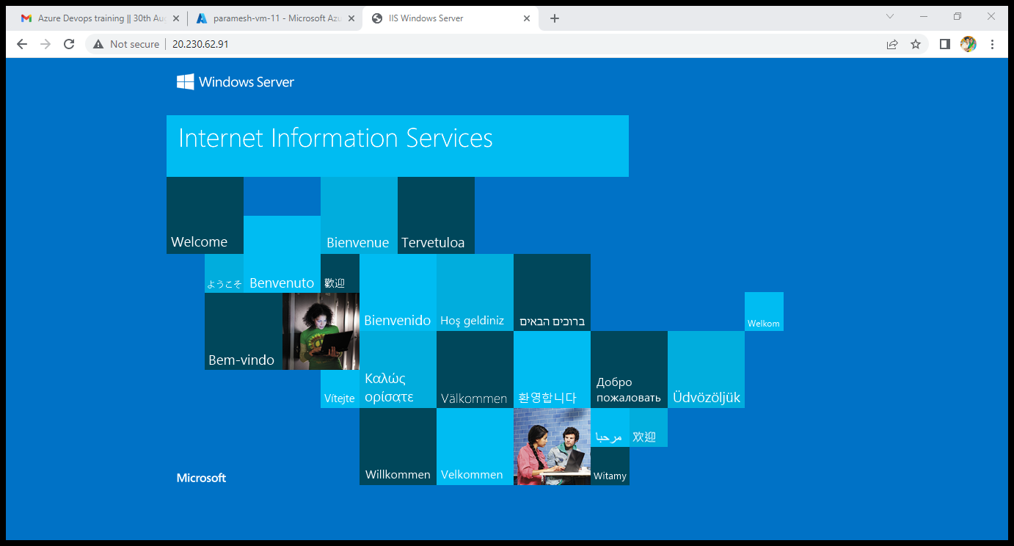
output

Slide 4
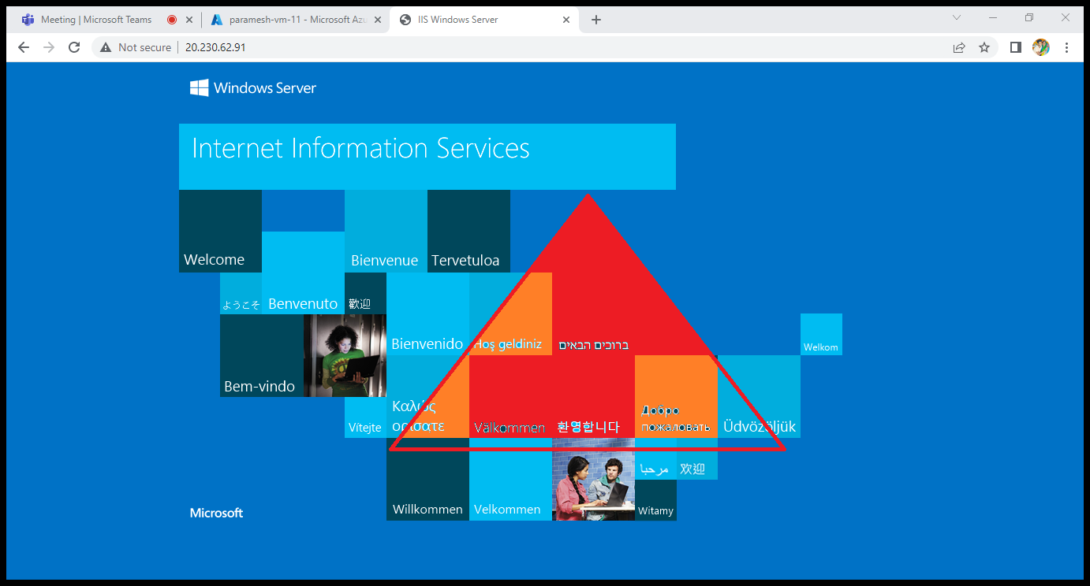
Out put

Slide 5
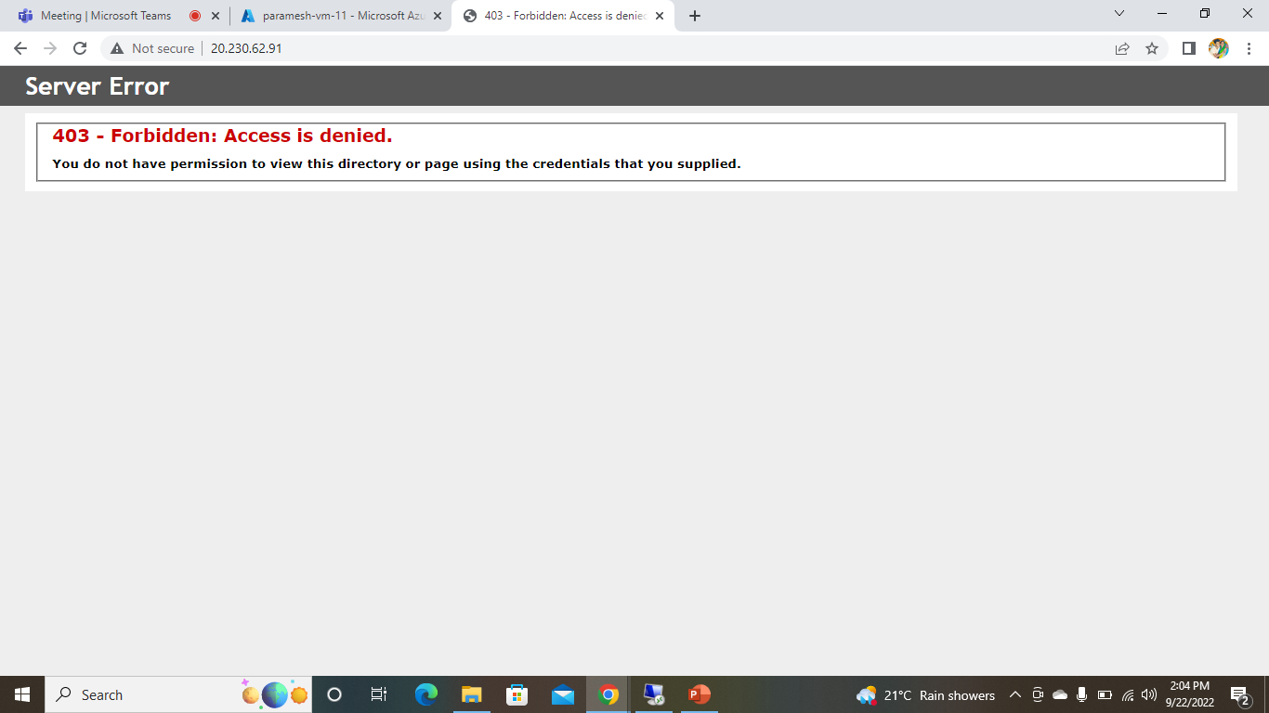
Added arm templates files but error showing

